Slide 1
Risk Management strategies that mitigate the impact of COVID-19
Lindiwe Ndaba – Portfolio Manager: Probity
City of Cape Town

Slide 2
Topics
Our Covid-19 Journey
Risk Management at the City
City’s Response to Manage Covid-19
Business Continuity
Risk Management Maturity (Using Real-Time Information to Enable an Agile Mentality Towards Risk Management)
Impact of Emerging Risks on Internal Audit Plans

Slide 3
Our Covid-19 Journey
Beyond July 2021 – Business Adaption
August 2020 – June 2021
Business Stabilisation
May – June 2020
Mini Recovery
March 2020 – “Shock” Business Disruption
January 2020 – Business Usual
Notes:
The road map depicts the City’s risk management journey pre, during and beyond Covid-19.
January 2020: Business Usual
Normal business operations and risk management processes
March 2020: Health “Shock” – Business Disruption due to Covid-19 Pandemic/ National Lockdown
Issuing of National Covid-19 regulations/ NT Circulars
Establishment of a Covid-19 Crisis Co-ordination Committee (CCC) across all EMT portfolios and under City Manager
City’s Response: A Dynamic Operating Framework developed
May 2020: Mini Recovery
After the initial shock the City experienced a mini recover due to the processes and plans put in place.
As part of our Resilience and Agility it was easier to prepare for the stabilisation phase.
August 2020: Stabilisation Focus:
Organisational stability (functional and financial); least disruption to service delivery, focus on efficiency (doing same/more with less), focus on effectiveness (focusing on what matters).
Investment in core services and in non-negotiable modernisation, include in capital projects which support the economy, to be defended.
Beyond July 2021: Adaptation focus:
Whilst still managing the pandemic and its impacts, build on new efficiencies in order to optimise service delivery with cost reduction.
Investment in core services and in non-negotiable modernisation, include in capital projects which support the economy, to be defended.

Slide 4
Risk Management at the City
Business Usual

Slide 5
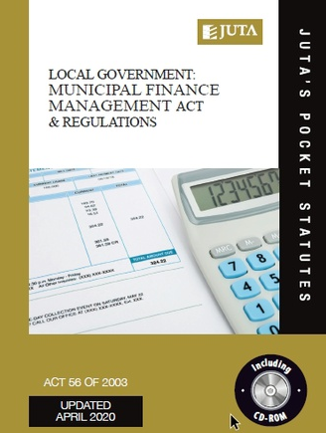
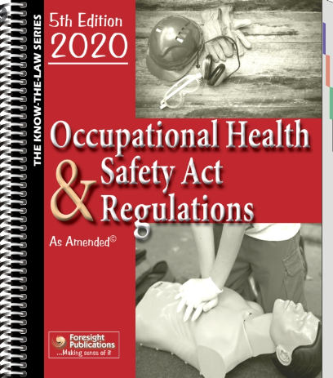
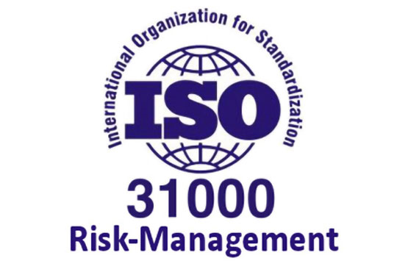
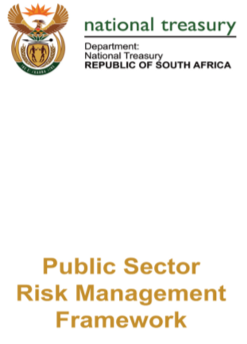
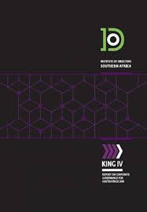
Regulatory Context: Regulations, Best Practices
Best practice for the City's risk management processes is informed by the following legislation and leading practices
Notes:
The Constitution of the Republic of South Africa, 1996 Section 152 states that:
" ( 1] The objects of local government are-
(a] to provide democratic and accountable government for local communities;"
Local Government: Municipal Finance Management Act, 2003 (Act No. 56 of 2003)
Section 62 states that:
"(1) The accounting officer of a municipality is responsible for managing the financial administration of the municipality, and must for this purpose take all reasonable steps to ensure -
(c) that the municipality has and maintains effective, efficient and transparent systems-
(i) of financial and risk management and internal control;
Section 65 states that:
"(2) The internal audit unit of a municipality or municipal entity must-
(b) advise the accounting officer and report to the audit committee on the implementation of the internal audit plan and matters relating to-
(iv] risk and risk management:“
Section 166 states that:
"(2) An audit committee is an independent advisory body which must-
(a) advise the municipal Council, the political office-bearers, the accounting officer and the management staff of the municipality, or the board of directors,
the accounting officer and the management staff of the municipal entity, on matters relating to - ... (ii] risk management;“
Sector specific legislation
All legislation relevant to the management of risk and internal control within the functional areas of the various assurance providers must be adhered to. Other legislation
having an impact on risk management inter-alia include: The Occupational Health and Safety Act, 1993 (Act No. 85 of 1993); Construction Regulations; Environmental
Legislation; Housing Legislation and The Consumer Protection Act, 2008 (Act No. 68 of 2008).
The Public Sector Risk Management Framework
The Public Sector Risk Management Framework (PSRMF) drafted by National Treasury sets the basis for risk management (identification, mitigation and monitoring) within
South Africa's public sector.
ISO 31000
ISO 31000 is an international standard that provides a generic approach, principles and guidelines for managing risk in a systematic, transparent and credible manner and within any scope and context. REG(IRM) used these standards as a guideline to effect best practices.

Slide 6
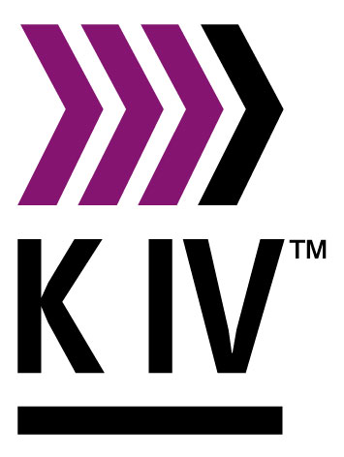
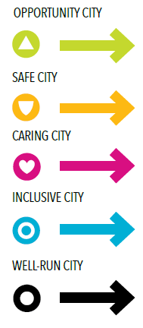
City’s Risk Management Philosophy
The City is committed to the optimal management of risk to achieve the City’s Vision, deliver on its core business and key objectives and protect its values as a Well-Run City.
The King IV has been adopted by Council on 5 December 2017.
Principle 11 of the supplement for municipalities states: "The council should govern risk in a way that supports the municipality in setting and achieving its strategic objectives:"
Notes:
The City has undertaken to embed a culture of IRM within the City and to identify, assess and manage risks, to monitor the management thereof and report thereon, in order to achieve the objectives of the City, as identified in the City's IDP.
IRM is the application of risk management throughout the City.
IRM recognises that risks (including opportunities) are dynamic, often highly interdependent and not to be managed in isolation.

Slide 7
Dashboard: City Wide Risks linked to SFA’s
Increased emphasis placed on the Strategic Focus Area (SFA) - Safe City
Notes:
Pre Covid-19 (June 2019)
This graph depicts, as a percentage, the 772 risks identified (at a strategic and departmental level) linked to the City’s strategic focus areas as at June 2019.
The Well-run City Strategic Focus Area (SFA), which is aimed at service delivery and value creation for customers in an operationally sustainable manner, is the area where the majority of the identified risks are linked to.
Post Covid-19 (August 2020)
The graph depicts, as a percentage, the 863 risks identified (at a strategic and departmental level) linked to the City’s strategic focus areas as at August 2020)
The Well-run City Strategic Focus Area, which is “about delivering services and creating value for customers in an operationally sustainable manner based on evidence-led decision-making so that the City can remain financially stable and resilient to shocks in a changing environment”, remains the area where the majority of the risks are linked.

Slide 8
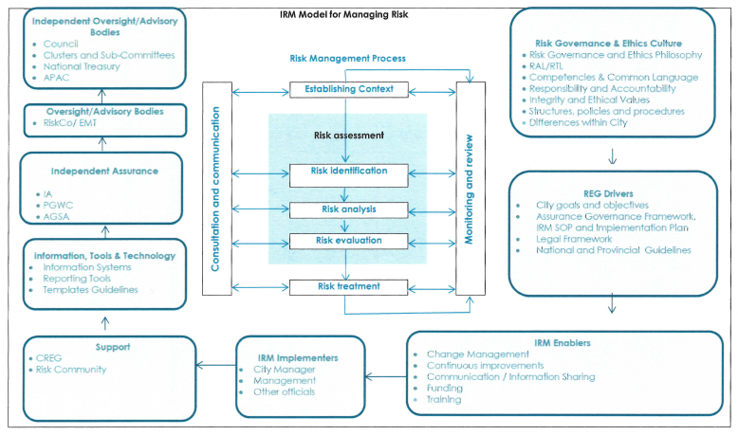
City’s Integrated Risk Management Model
Automate Risk Assessment Using ITT
Manual Process
Notes:
The City is committed to implementing and institutionalising an effective, efficient and transparent system of IRM. The City's IRM process consists of five steps as depicted in the centre of the diagram. These five steps above are performed by relevant stakeholders on an on-going basis. To however ensure key risks are fully unpacked and mitigated the following minimum processes need to be adhered to:
• Risk Owners, with assistance from their Risk Champions or Coordinators are expected to ensure discussion of their risk register at monthly management meetings and escalation of any significant new risks that should be unpacked and mitigated on their risk registers.
• Risk Register workshops, facilitated by IRM stream leads will be held with risk owners or assurance providers in accordance with the annual IRM work plan (annual
schedule of formal review sessions).
• Executive Directors are expected to discuss their risk register with their relevant Mayco member on a 6 monthly basis, whilst IRM stream leads will forward signed off
executive risk registers to the Mayco members within 7 days from receipt.
• Oversight is furthermore executed in accordance with RiskCo and APAC's ToR.
Currently Risk Identification, Risk Analysis and Risk Evaluation steps of the IRM processes are all manual. Automation of these processes is essential for risk management to remain relevant and continue to add value to the organisation. Using real-time information and on-going data analytics is required to maintain an agile risk management approach.

Slide 9
The Impact of COVID-19 on Risk Management
1. Identify Risks
Your risk profile has changed - catalogue risks you may face over the next month, three months, six months, nine months and year.
2. Be Agile
Be ready to be uncomfortable - Navigate this period with flexibility and understanding to meet the needs of the stakeholders.
3. Think People
Today people are stressed, tired, taxed, scared and pre-occupied - risks associated with mismanaging employees in this time can be significant
4. Be Resilient
Evaluate the impact of COVID-19 on business continuity, looking both internally (critical functions, equipment, employees) and externally (SCM analysis)
5. Think Automation
Using real-time data and on-going data analytics will assist with improved evidenced based decision making and a value-adding risk management approach.
6. Consider your reputation
The success stories of COVID-19 will be the people and organizations whose reputation was improved with their response to the pandemic.
7. Consult Advisors
This is a time for everyone to work together – consider reaching out to other municipalities and consultants in Risk, Legal, Insurance, Financial, psychology
Notes:
Source: Gowling WLG - Jahmiah Ferdinand-Hodkin
All organizations can use the basic principles of risk management to shape a path through the COVID-19 pandemic and minimize the lasting negative impacts. Whether you have a robust Enterprise Risk Management (ERM) program in place or have not yet turned your corporate mind to risk management, the principles outlined below can help you move through this crisis and beyond:
1. Identify your risks
Organizations use risk management to "predict the unpredictable." To navigate the risks (and opportunities) associated with the pandemic, it is critical to first identify what those risks are. Indeed, the exceptional circumstances surrounding COVID-19 may have brought to light risks you had not yet considered – or may have imbued previously identified risks with a new sense of urgency. Whatever the case may be, before moving in any one direction take a moment to catalogue the risks your company may face over the next month, three months, six months, nine months and year.
In order to accomplish this most effectively, you should:
•Consider all kinds of risks – including operational, strategic, financial and reputational;
•Gather information from all employee levels and from a large cross-section of stakeholders (clients, vendors, etc.) – they might be in a position to identify risks that you would not think of;
•Look at other organizations, in Canada and abroad, and consider what they are facing; their risks might be the same as yours or perhaps their risks will create risks for you down the line (think supply chains).
Dig deep into this exercise before you move on, and return to it often over the next year, two years and five years so that you can update your risk profile as the world progresses through these unprecedented times.
2. Be agile
Albert Einstein said "learn from yesterday, live for today, hope for tomorrow. The important thing is not to stop questioning." The world is collectively questioning everything as we navigate a new normal. The plans that you had two months ago are no longer appropriate, feasible or realistic for today.
Do not throw your entire play-book out but instead return to your values and redefine how you will realize them. Be ready to be uncomfortable. Navigate this period with flexibility and understanding. Be creative in your approach to moving forward, listen to what your stakeholders want and need and consider how you can pivot to fill a void.
3. Think people
The backbone of every organization lies in its people. Today people are stressed, tired, taxed, scared and pre-occupied. The organizational risks associated with mismanaging your employees in this time can be significant (health and safety, financial, reputational, legal, operational, to name a few).
Where then do we start? People generally need to feel heard, they need to be able to trust and they need to have information. Let your employees know that you have a risk plan, a business continuity plan, and a crisis plan – and take the time to communicate what each plan entails and how it will evolve, while also seeking their engagement and input.
ERM works because it fosters and relies upon a holistic approach to identifying, analyzing, evaluating and treating risk. While it has to be fully endorsed and supported by top management, it must involve the entire organization in order to succeed. ERM also encourages frequent communication between all levels of the organization, which in turn leads to greater transparency and trust.
As we move through this pandemic, we see that the heroes come in all uniforms – from the delivery drivers, to the cleaners, to the grocery store clerks, to the health professionals. The heroes within your organizations will also come in all roles. Consider how you can make their days easier in order for them to be more physically and mentally able to help you. Whether it is implementing flexible work hours or ensuring that they have a computer at their home, it starts with asking them what they need to do their job during these times.
4. Be Resilient
Evaluate the impact of Covid-19 on the continuity of your business process. The purpose of business continuity is remain resilient and ensure that your business is able to survive a critical incident. It consists of a series of plans implemented over phases to shorten recovery time and mitigate impact. For more information regarding business continuity, please see Gowling WLG's article "Business Continuity Planning in COVID-19."
Now is a reasonable time to evaluate the impact of COVID-19 on your organization, looking both internally and externally:
•Internally: This involves identifying business critical functions, equipment and employees, and determining how, where and by whom critical services are provided. You may consider suspending non-essential work to reduce risk of exposure, to support social distancing and to reduce unnecessary cash expenditures. Ensure you carefully monitor employee availability, health and safety. As all people are at risk of being personally impacted by COVID-19, a continuity plan must be developed for all business critical employees that can be easily triggered should they become indisposed. The chain of command must be clearly identified and alternates and designates put in place for all critical functions.
•Externally: This requires a supply chain analysis and assessment of the possible risks faced by vendors, manufacturers, suppliers, distributors, purchasers and all organizations and stakeholders that you interact with and rely upon.
Amid government restrictions and instructions to "stay home," the use of technology is exceptionally important for many organizations. Most have already mobilized an infrastructure to support remote working. To increase productivity and reduce interruption, ensure that employees have the necessary hardware, software, equipment and internet connectivity to work safely and efficiently from home. Also ensure that your IT infrastructure can support the increased pressure from a significant portion of your team working from home.
The new normal has created the need for new policies and procedures. On the technology side, the remote working world has greatly increased the risk for cyber attacks and phishing. Employees must be aware of these risks and trained on the new policies pertaining to the use of technology and the transfer of information and funds. If employees remain onsite to work, organizations will need to address health and safety concerns through new and evolving policies.
Consider your internal and external communication plan. Updates need to be communicated to stakeholders in real time. The situation is constantly evolving and appropriate measures need to be implemented such that communication can be disseminated immediately.
5. Use Real-Time Data
Using real-time data and on-going data analytics will assist with improved evidenced based decision making and a value-adding risk management approach. (this will be unpacked in greater detail under the section that speaks to the Maturity of Risk Management.
6. Consider your reputation
Last, consider your reputation. The success stories of COVID-19 will be the people and organizations whose reputation was improved with their response to the pandemic.
When the dust settles, people will remember companies donating salaries or delivering food parcels to help others. Also the companies that re-deployed workforces and production capabilities to create and produce personal protective equipment for frontline workers, hand sanitizers for health professionals and technology to help track the spread of the disease. The City assisted the needy by handing out food parcels to the needy and erected temporary housing in the form of tents for the homeless in strandfontein. The City received negative publicity and came under scrutiny from the human rights commission for the latter.
For those organizations that take a short-sighted view of the pandemic, by price gouging or supply hoarding, the long-term negative reputational impact may far outweigh the short term benefits experienced.
7. Consult with advisers
This is the time for everyone to work together. Consider reaching out to:
•An outside risk management consultant: We can assist you in identifying, analyzing, evaluating and treating your risks. If you do not have a business continuity, incident management, risk management or crisis plan, or if the ones you do have are not working, it is not too late to seek advice to review, improve, create or implement.
•Legal counsel: We can help you navigate new and rapidly changing legislation, assist you with managing health & safety, employee, regulatory, essential service, insurance, travel, and contractual issues, to name a few, that present themselves.
•Insurance broker: Can help you understand your current insurance policies and advise whether you have coverage that can assist you and how.
•Financial advisers: Can discuss which financial incentives, loans, government programs, deferrals, etc. are available to you and how can you access them.
•Mental health professionals: Your staff may need support during these times. Finding a way to get that support to them may prove invaluable.

Slide 10
City’s Response to Manage Covid-19
Pandemic “Shock” - Business Disruption

Slide 11
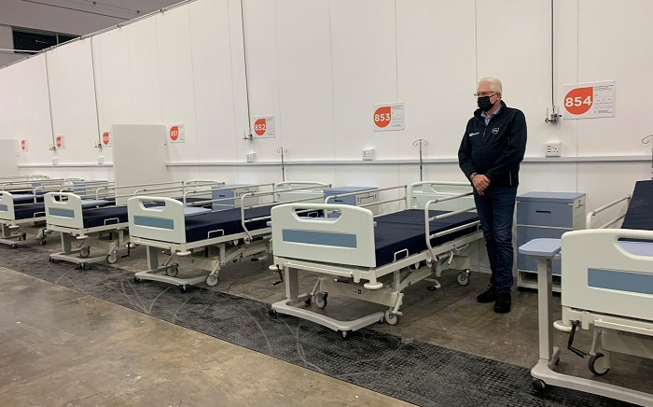
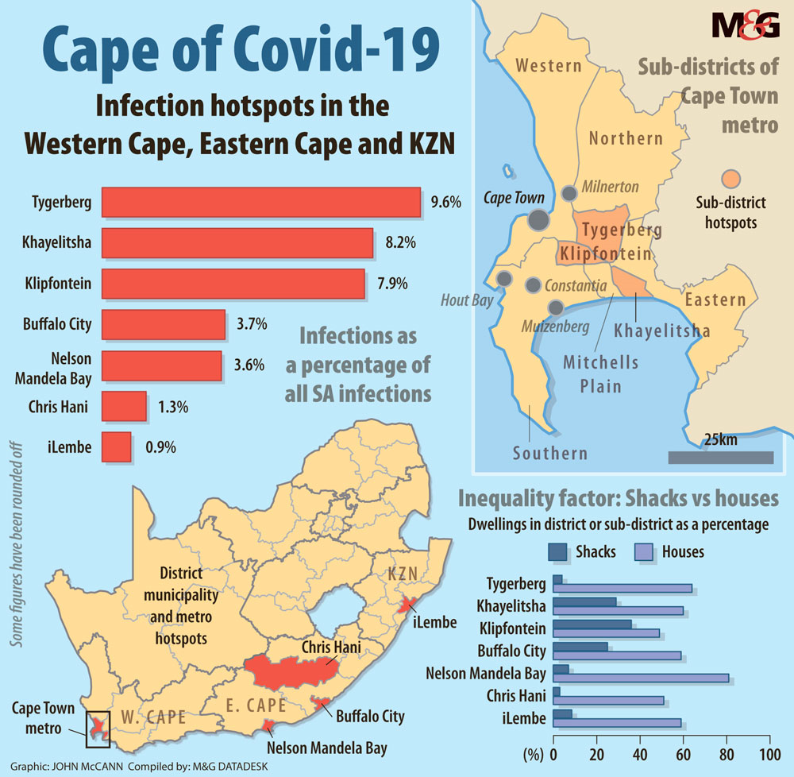
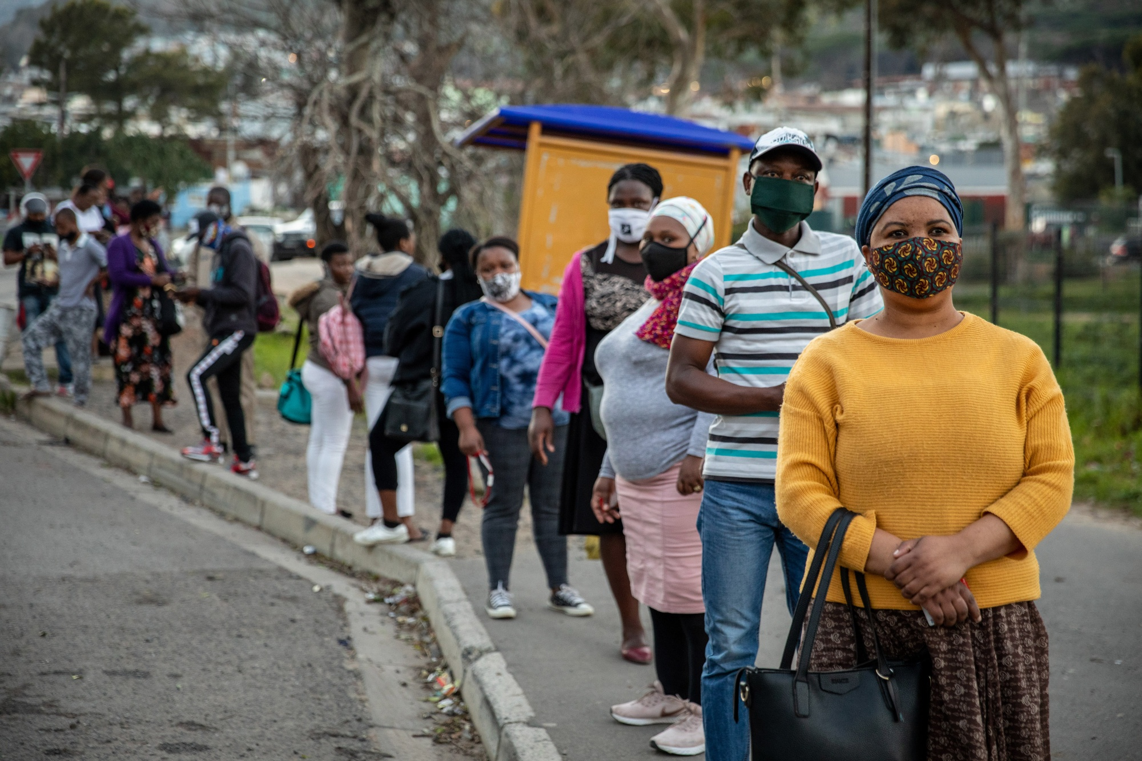
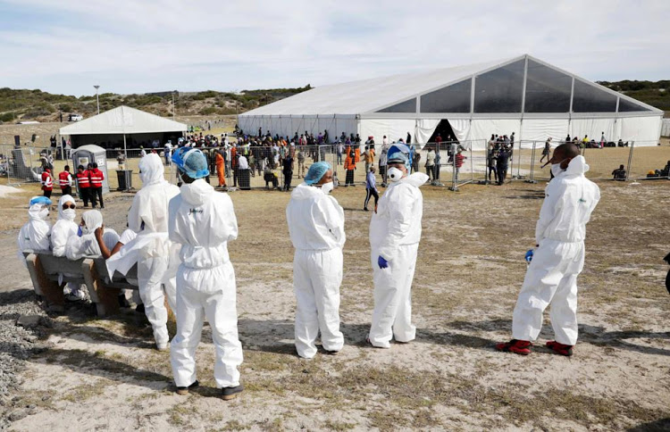
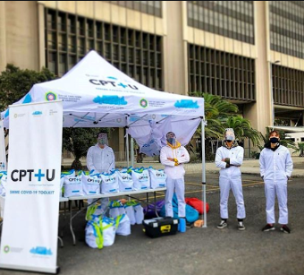
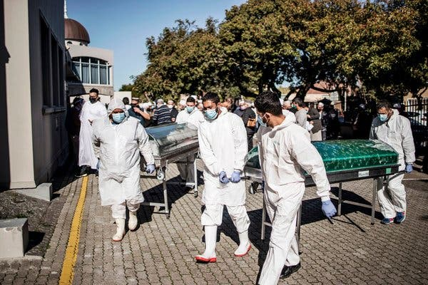
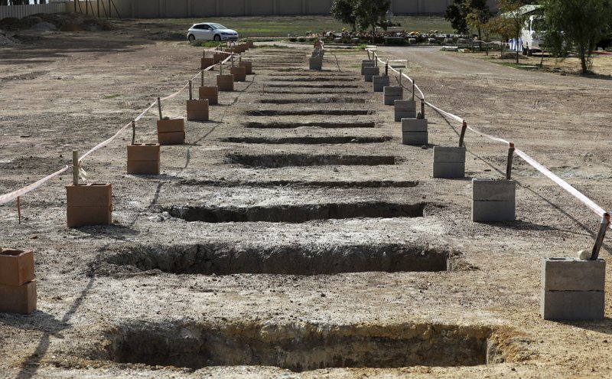
Impact of Covid-19 and National Lockdown on Cape Town
Notes:
1. Drown footage shows Cape Town turned into a ghost town during the national lockdown.
2. MyCiti signs showing the requirements to wear masks when in the public space and travelling on public transport.
3. CTICC turned into a field hospital:
Western Cape Premier Allan Winde on 25 May 2020 examined the province’s makeshift COVID-19 field hospital at the Cape Town International Convention Centre.
4. Standfontein sports ground turned into a massive temporary shelter that houses homeless people who have been removed from Cape Town’s streets to limit their exposure to the virus. The site hosts about 1 500 homeless people, with space for about 2 000 people in total. There are four large marquee tents. Inside this is a floor base with mattresses lined up. This is the main sleeping area. There are smaller tents alongside used as a medical station, food halls, and storage facilities.
5. The Western Cape accounted for two thirds of South Africa’s Covid-19 cases — many in poor, crowded townships.
6. Residents wait at a bus stop near Hout Bay, in Cape Town.
7. Undertakers carrying coffins at the end of a funeral for coronavirus victims in Cape Town. Deaths in cape town during the lockdown and pandemic created unprecedented predicaments for people to bury their loved ones from a cultural and religious perspective. For example in the Muslim faith same day burials are required, in the black community the body of the deceased needs to be returned home for a funeral, accompanied by loved ones from Cape Town.
8. CAPE TOWN - Mass graves were proposed as a solution to the projected 9 000-plus deaths from Covid-19 in the province. The Western Cape at one point had the highest recorded deaths from the coronavirus in the country.
9. City of Cape Town handing out free Covid-19 test kits to small businesses.

Slide 12
NT Circular 103
Circular 103 provides for preventative measures in response to COVID-19 and highlights key control/ risk considerations.
Remote Working
Reliance on electronic submissions rather than manual submissions
Contingency plans
Unavailability of key personnel who execute internal controls.
Changes in delegations and/or levels of authority or the establishment of new reporting lines.
Lack or limited education, training sessions or supervision may lead to risk of incorrectly executing new and/or existing internal controls or applying internal policies.
Education, training sessions or supervision
Increased possible risk of error
Failure to timely assess and subsequently address the impact of changes caused by external environment factors.
Timely Access
Leadership and stakeholders
Failure to involve appropriate levels of leadership and stakeholders in decision-making process could lead to inappropriate or rushed changes in the processes and controls.
Notes:
Circular 103 is most relevant to risk and audit professionals.
The purpose of this Circular when dealing with the COVID-19 pandemic is to:
provide for preventative measures as a result of COVID 19 emergencies and the need to be responsive and flexible, whilst ensuring value for money and minimising the risk of fraud, corruption, negligence, error, incapacity; and
ensure that internal control systems of a municipality and municipal entity consider, amongst others-
the change in operating activities of the existing control environment;
revisiting risk assessment processes;
designing and/or amending control activities to address new or elevated risks;
identifying information required to support the effectiveness and efficiency of new or existing controls;
reassessing internal and external communication; and
identifying any additional internal control monitoring activities

Slide 13
Essential Services and Assurance Providers During Covid-19
Frontline/ Essential Services
Level 1 AP
S&S: Traffic, Metro Police & Law Enforcement
Level 2 AP
DRM
Ethics
Governance & Combined Assurance
Level 4 AP
AGSA
External Regulators
CSH: Clinics & Healthcare
Line Management
ECC: Electricity
WWS: Water & Solid Waste
HS: Apply restriction on PIE Act
EOAM: Fleet & Facilities Management
SPE: Building Development Management
HR
IS&T
BCM
OHS
SCM
Legal Services
IRM
Finance
Forensic Services
Ombudsman
Internal Audit
Level 3 AP
Internal Advisory Committees: RiskCo, CCC, EMT
Independent Advisory Committees: APAC
Council and Council Committees: PCs and MayCo
Notes:
Level 1 Assurance Providers
These assurance providers continued to provide services to the public deemed to be essential during the Covid-19 pandemic and national lockdown.
Line managers continued to direct, supervise and monitor staff well-being and productivity under national lockdown
S&S continued to provide enforcement services to ensure community compliance with national lockdown regulations
CSH provided the necessary healthcare and clinic facilities to ensure treatment of primary health care requirements as well as Covid-19 related needs
ECC ensure continued provision of electricity services, deemed a basic service in terms of the constitution.
WWS continued to not only provide water and solid waste services to all residents, but also provided extra water services i.e. Water tanks to informal settlements for sanitation purposes e.g. washing of hands in information settlements. This additional service is not envisaged to continue beyond the state of disaster.
HS: Monitoring and ensuring adherence to the restriction placed on the application of the Prevention of Illegal Eviction Act during the national lockdown and state of disaster.
EOAM: Management of fleet e.g. restricting use of pool vehicles to essential services to ensure sufficient fleet available to meet service delivery needs in event of breakdowns as workshops were closed. Ensure buildings were Covid-19 compliant e.g. installation of hand sanitizers, installation of Perspex screens, ventilation operational, installing Covid-19 information signage, etc.
SPE: although not deemed an essential service, SPE continued providing the service of review and approval of building plans to the public via on-line processes.
Level 2 Assurance Providers:
These were deemed as the essential specialist functions assisting with risk mitigation/ management of Covid-19 related risks. Their roles and responsibilities will be discussed in greater detail over the next few slides.
Level 3 Assurance Providers:
Provide assurance on the identification, management, monitoring and reporting of Covid-19 related risks
Provide assurance on the compliance to Covid-19 regulations and City Covid-19 policies/ frameworks/ guidelines/ directives.
Level 4 Assurance Providers:
AGSA audit on compliance to Covid-19 regulations.
External regulators like the human rights commission (Strandfontein temporary housing came under scrutiny as a result of failure to ensure social distancing in tents, adequate ventilation, etc.)

Slide 14
Covid-19 Risk Governance Structure
Line managers had a key role to play as risk practitioners relevant to the impact of Covid-19 on their related functional areas/ service deliver operations
Committee included HR, Resilience, IS&T, Facilities Mgnt, Fleet Mgmt, Risk & Ethics, Communications, Customer Relations, and Legal Services
The CCC is also the Chief Resilience Officer
CCC reports to the City Manager and provides EMT with regular updates
Governance reporting to political leadership headed by the Executive Mayor via City Manager and EMT, with reports to the Council and/or Disaster structures as appropriate
Meets with all the pandemic response stream leads from across the organisation to interpret the data
MAYCO
EMT
Pandemic Business
Continuity CoordinatingCommittee
Central Crisis Coordinator
Line Managers
Notes:
At the onset of the COVID-19 disaster, the City established the COVID-19 Coordination Team, under the leadership of the Central Crisis Coordinator (CCC), which was tasked with conceptualising and managing the holistic approach to the crisis as it unfolded.
Each week, commencing in late April 2020, the CCC, who is also the Chief Resilience Officer, met with all the pandemic response stream leads from across the organisation to interpret the data (the shed) coming in from multiple sources in order to inform the clock positions of each system.
The Strategic update presentation would then be presented first by the CCC to the Executive Management Team (EMT), usually on a Thursday, and then to the Mayoral Committee, usually on a Friday.

Slide 15
Risk & Assurance Professionals Roles and Responsibilities
Level 2 Assurance Providers Essential During Covid-19 | Role and Responsibility
Disaster Risk Management | Establishing temporary housing for the homeless (Strandfontein, Culemborg, Bellville) Facilities for Refugees (Strandfontein, Wingfield)
Occupational Health & Safety | Hazard Identification Risk Assessments Return to Work Framework and Guidelines Monitoring and reporting of Staff Covid-19 Cases
Information Systems & Technology | Provision of adequate IT infrastructure to support remote working (e.g. network accessibility via 3G, VPN, etc.) Support to staff for skype meetings Ensuring IT infrastructure of council meetings at various venues
Supply Chain Management | Maintaining sufficient critical inventory needs to mitigate Covid-19 e.g. PPE, sanitizers, etc. Maintaining inventory to ensure continued service delivery to citizens Deviation co-ordination Ensure application to NT Covid-19 Circulars related to Procurement (where relevant)

Slide 16
Risk & Assurance Professionals Roles and Responsibilities
Level 2 Assurance Providers Essential During Covid-19 | Role and Responsibility
Human Resources | Remote working arrangement directives Processing of COVID-19 COID claims
Business Continuity Management | Active participants on the Covid19 Co-ordinating Committee Facilitating Business Continuity Plans linked to Return to Work Plans
Legal Services | Court Proceedings/ Litigation - Risk Mitigation Provide/ Seek Legal Opinions
Integrated Risk Management | Active participants on the Covid19 Co-ordinating Committee Facilitation of on-going risk processes ensuring consideration of Covid-19 risks.
Finance | Application for disaster emergency funding Application for grant capital funding to be repurposed for operational demands Ensure application to NT Covid-19 Circulars related to budget and financial statements (where relevant)

Slide 17
City’s Response: A Dynamic Operational Framework
Covid-19 fast-tracked the City automated approach to risk management, that is moving from a manual system to using real-time data and data analytics.
The result – Development of a Dynamic Operating Framework.
Key components include:
Shifting of risks depending on the alert level
The alert level is primarily informed by the infection rate (or risk of infection) and availability/allocation of resources within the entire system (e.g. shortage of PPE necessitates prioritisation of certain systems over others)
Response to risk – awareness of specific risk for each system AND understanding the implications of the alert-level in mitigating the risk.
Risks have therefore been identified in each system across each alert level.
The level of risk is evaluated against response criteria, but those response criteria increase/decrease depending on the alert-level.

Slide 18
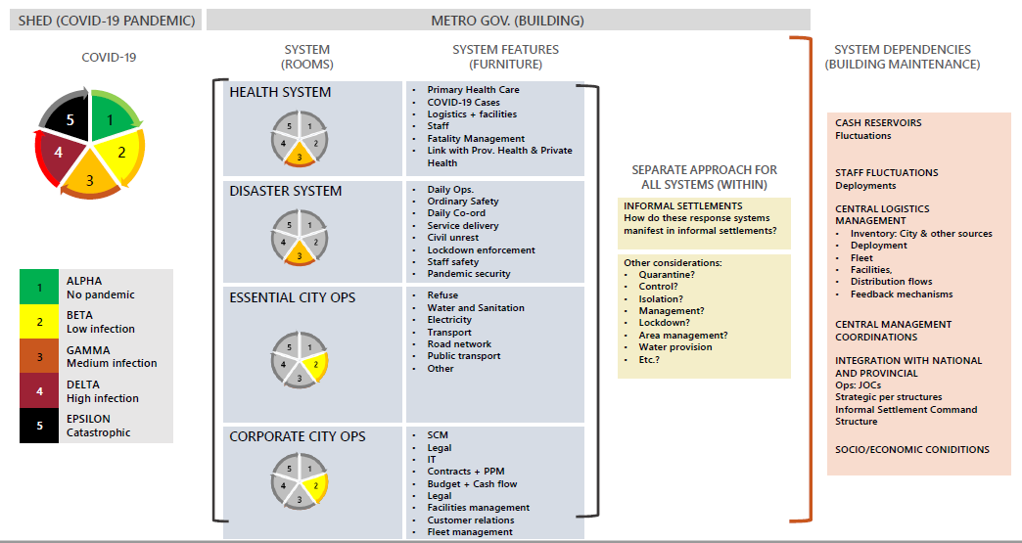
City’s Response: A Dynamic Operational Framework
Notes:
Health System
Build the health system response based on scientific/medical information and respond to Public Health requirements
Disaster System
Mapping out the configurations of the system for disaster management and its resources
Essential City Operations
Deliver essential City operations and functional procedures under conditions of extreme suppression of the virus, such as phases of lockdowns
Corporate City Operations
Manage the supporting Corporate Operations to ensure the sustainability of the organisation

Slide 19
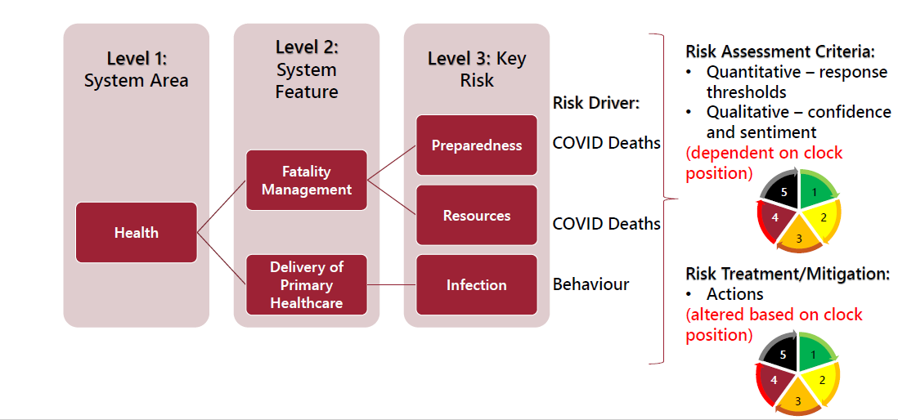
Risk Identification in systems

Slide 20
Links to Corporate Risk Register
Systems risk informs decision making for strategic planning – decisions beyond the tactical.
Key systemic risks have been included in the Corporate Risk Register and will be Governed accordingly.
The management of the system risks and their escalation will follow institutional risk processes in order to track and mitigate risks as the pandemic unfolds
Corporate Risk Register Component | COVID Risk Approach
Risk Title | Identified Risk Driver
Consequence | Risk Assessment (based on systemic approach)
Controls and Action Plan | Mitigation/Risk Treatment
Ownership of actions by relevant party
Oversight by relevant body

Slide 21
City’s Corporate Risk Register – July 2020
IMMIGRATION
Notes:
A graphic display of the top 10 risks being managed on the CCTCRR. The CCTCRR was revisited and updated to ensure consequence, controls and action plans related to Covid-19 were identified, documented and monitored.
For example:
Governance and compliance now includes controls and action plans such as:
Control: EMT meetings with MayCo twice a week with regards to establishment of COVID-19 policy and strategy aspects.
Control: Monitoring and review of the implementation of COVID-19 Regulations (incl. OH&S related matters) and the City's reactions thereto via the Pandemic Business Continuity Committee
Action plan: City manager Directives and COVID-19 advisories action plan to be developed
Crime, health and safety:
Control: Coordinate programmes and COVID-19 response strategy and decision making by the Covid-19 Coordination Committee (CCC)
Control: Coordinated actions and communications to effect Social Distancing and Handwashing
Control: Daily City JoC meetings to look into, monitor and review incidents relating to COVID-19 and incidents relating to the lockdown regulations.

Slide 22
Business Continuity
Business Stabilisation

Slide 23
Resilience
Embracing the principles of resilience in our approach to continued service delivery

Slide 24
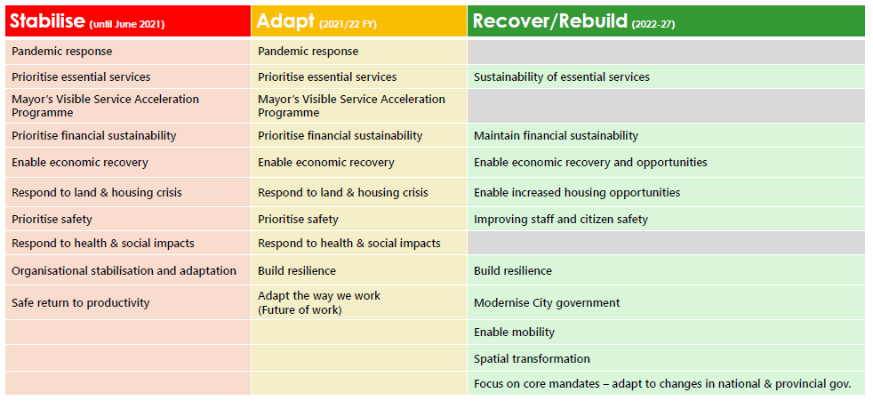
Strategic Management Framework
The City developed a SMF, the purpose of which:
Provides high level direction for planning and budgeting (2021/2022 and MTREF)
Presents strategic priorities in relation to resource base and new realities.
Guides the hard choices and decisions to respond to emerging needs and risks.

Slide 25
Being in the Know
Notes:
Keeping the staff and public in the know regarding Covid-19 developments in the City, essential and non-essential services affected by Covid-19.

Slide 26
The New Normal
As CoCT staff we must set the example for the Public
Working from home (where possible)
Skype Meetings
Doing more with less (Budget constraints due to economy shock)
Doing things smarter by applying re-engineering, innovation, automation of processes (on-line processes to be expedited)

Slide 27
Risk Management Maturity
Business Adaption

Slide 28
Agile Approach to Risk Management
Form cross-functional teams that span across business, risk, compliance, operations, economists and evaluate the problem holistically e.g. Covid-19 Coordinating Committee included amongst others, participants from Resilience, BCM, IRM, OHS, line management, etc.
Heightened cyber vulnerability alerts – revisit preventative controls on critical IT components/ applications.
Impact of shocks and stresses in the future e.g. stoppage of on-line services due to ransomware
Be pragmatic, forward thinking and future driven. Take your existing capabilities, re-purpose them into prototypes and continue to evolve.
Notes:
Form cross-functional teams that span across business, risk, compliance, operations, economists and evaluate the problem holistically e.g. Covid-19 Coordinating Committee included amongst others, participants from Resilience, BCM, IRM, OHS, line management, etc.
Heightened cyber vulnerability alerts – revisit preventative controls on critical IT components/ applications.
Impact of shocks and stresses in the future e.g. stoppage of on-line services due to ransomware
Be pragmatic, forward thinking and future driven. Take your existing capabilities, re-purpose them into prototypes and continue to evolve.

Slide 29
Using real-time data and data analytics to improve the efficiency of Risk Management
Identify the type of data that is available
Define the scope of the data required
Request the data as defined in the scope
Compile a pilot engagement plan with the right stakeholders
Perform a design adequacy assessment of the above plan
Assess the pilot project outcomes in response to the objectives of the project
Roll out an easy to use risk dashboard
In collaboration with data management/ scientists, assess data sets available that could facilitate predictable modelling.
Ensure expert knowledge is utilised when data is made available to risk management.

Slide 30
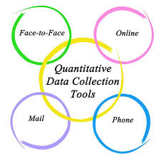
Looking forward – Integrated Risk Management at the City
Risk Management Innovative Tools
Risk maps - dashboards
Modelling tools
Qualitative techniques
Potential summary charts and diagrams that help directorates identify, discuss,
understand and address risks by portraying sources and types of risks and disciplines involved/needed.
Enquiries on usage of qualitative techniques such as surveys, questionnaires, and self-assessment to identify and assess risk and risk management approaches
Utilisation of modelling tools such as scenario analysis and forecasting models to show the range of possibilities and to build scenarios into contingency plans

Slide 31
The tool maps out the systems and associated sub-systems with risk drivers, effort applied to manage the risk
The risk management tool is integrated with the City’s Corporate Register to ensure that duplication of effort is minimized.
Strategic update presentation
Risk Tools Deployment
Real-time Risk Management
Mapping all drivers and aspects of the Covid-19 response programme in a single space, actively managing the entire system response and identify risk that need to be escalated.
Management to actively manage the entire system response
The tool will be used to verify, integrate and escalate residual risk.
Pre-Pandemic
Pandemic-alert
Pandemic
Pandemic
Post-Pandemic
Way-forward
City established the Covid-19 Coordinating Team under the leadership of the Central Crisis Coordinator (CCC)
The Strategic update presentation created with all relevant information, analysis, clock position, decisions and commentary.
Real-time threat management system:
Threat monitoring intelligence
Data and real-time analytics to enhance risk detection and risk management platforms
Automate risk management responses
Risk Methods and process was deployed for pandemic response:
Dynamic Operational Framework
Pandemic Risk Management Tool
Decision Tool
Business Continuity Plan
Presented to EMT every Thursday and Mayoral Committee on Fridays.
Manual Risk Management
Pandemic Risk Management tool
Integrated with the CCTCRR
Notes:
January 2020 - Manual Risk Management Processes
March 2020 - Risk Tools Deployment
City established the Covid-19 Coordinating Team under the leadership of the Central Crisis Coordinator (CCC)
Risk Methods and process was deployed for pandemic response:
Dynamic Operational Framework
Pandemic Risk Management Tool
Decision Tool
Business Continuity Plan
April 2020 - Pandemic Risk Management tool
The tool maps out the systems and associated sub-systems with risk drivers, effort applied to manage the risk
Mapping all drivers and aspects of the Covid-19 response programme in a single space, actively managing the entire system response and identify risk that need to be escalated.
July 2020 - Strategic update presentation
The Strategic update presentation created with all relevant information, analysis, clock position, decisions and commentary.
Presented to Executive Management Team (EMT) every Thursday and Mayoral Committee on Fridays.
August 2020 - Integrates with the CCTCRR
The risk management tool is integrated with the City’s Corporate Register to ensure that duplication of effort is minimized.
Management to actively manage the entire system response.
The tool will be used to verify, integrate and escalate residual risk.
July 2021 – Real time risk management
Real-time threat management system:
Threat monitoring intelligence
Data and real-time analytics to enhance risk detection and risk management platforms
Automate risk management responses

Slide 32
Impact of Emerging Risks on Internal Audit Plans
Business Adaption Continued

Slide 33
Annual Internal Audit Plan Road-Map
MAY ‘20
AUG ‘20
Revised (Covid -19) AIAP Approved by by MayCo
20/21 AIAP Approved by MayCo
Drafting 20/21 AIAP
20/21 AIAP Approved by APAC
Revised (Covid -19) AIAP Approved by APAC
FEB ‘20
JUN ‘20
AUG ‘20
Notes:
The original 20/21 annual internal audit plan was approved by APAC in May 20 and by MayCo in June 20, where after it was revised to ensure risks related to Covid-19 were considered and audit engagements included on the audit plan to address these.

Slide 34
Adjusted Internal Audit Plan post Covid-19
The revised 20/21 Annual Internal Audit Plan included engagements in response to Covid-19.
Examples of new engagements included, but not limited to:
COVID-19 - Compliance Checklist and Audit File Guidance
Occupational Health and Safety
COVID 19 - CSA Advisory - Workplace Readiness Assessment
COVID19 - Compliance & Functionality Checklist: Direction 6.7.2(a) in the Government Gazette (No.43147)
COVID 19 - Performance Target Reviews (SMART)
Virtual Private Network (VPN) and 3G Security Review
Data Analytics Review: PPE Inventory (COVID)
Disaster Risk Management Advisory Forum
Emergency Procurement
COVID-19 - Response Planning and Implementation: Direction 6.2.1 (b and c)
Contractor performance management - COVID-19
Grant Funding Covid-19 related Expenditure

Slide 35
Emerging Risks Related to Covid-19
As a result of Covid-19 the risk landscape has changed resulting in a shift in impact on corporate risks.
Health and safety risks e.g. limited healthcare resources to service the public, employee wellness, etc.
SCM risks e.g. deviations and condonations relating to PPE, Irregular expenditure, etc.
Cybercrime and security risks e.g. system hacking via home / public networks, data security, etc.
Reputational risks e.g. Strandfontein homeless shelters
Human Settlements e.g. land invasions, squatting, etc.
Regulatory risks e.g. NT circulars, application GRAP related to Covid-19, etc.
Fraud risks e.g. tender kickbacks/ collusion, bid rigging, etc.
Notes:
As a result of Covid-19 the risk landscape has changed resulting in a shift in impact on corporate risks.
Health and safety risks e.g. limited healthcare resources to service the public, employee wellness, etc.
SCM risks e.g. deviations and condonations relating to PPE, Irregular expenditure, etc.
Cybercrime and security risks e.g. system hacking via home / public networks, data security, etc.
Reputational risks e.g. Strandfontein homeless shelters
Human Settlements e.g. land invasions, squatting, etc.
Regulatory risks e.g. NT circulars, application GRAP related to Covid-19, etc.
Fraud risks e.g. tender kickbacks/ collusion, bid rigging, etc.
IA should be AGILE in their approach and their focus of IA should shift from assurance to hybrid engagements. Mitigation of Covid-19 risks are still in an infancy stage and thus requires a balanced approached between assurance and advisory depending on the needs of the organisation.
IA’s approach should be on improvement and not enforcement to allow for newly developed control process to mature and be embedded in the organisation.

Slide 36
Agile Auditing
Agile Internal Audit allows the internal audit function to focus on stakeholder needs, accelerate audit cycles, drive timely insights, reduce wasted effort, and generate less documentation.
In an Agile Internal Audit, internal auditors and stakeholders are able to determine, up front, the value to be delivered by an audit or project. As the internal audit function considers its specific challenges and contemplates a custom solution, Agile helps prioritize audits based on risk and the readiness to undertake the work
Source: Deloitte
Notes:
IA should be AGILE in their approach and their focus of IA should shift from assurance to hybrid engagements. Mitigation of Covid-19 risks are still in an infancy stage and thus requires a balanced approached between assurance and advisory depending on the needs of the organisation.

Slide 37
For queries contact Lindiwe.Ndaba@capetown.gov.za

