Slide 1
Effective leadership mitigates the risk of fraud and corruption
Jodi Joseph
Divisional Executive - CaseWare Africa
Notes:
Hello everyone, it's great to have the opportunity to spend some time with you and share thoughts on leadership’s role in mitigating fraud and corruption.
My name is Jodi Joseph. I am the divisional executive for CaseWare at Adapt IT. I am a Chartered accountant and spent much of my career as a CFO. As a result, I see the world through numbers and performance both financial and non financial.
I also stand here as a passionate South African citizen and feel very lucky that I work in a business whose purpose it is to enable compliance and create capacity for financial professionals across all market segments to take up their role in a much more effective way and enabling them to have maximum impact in the area they operate.
At CaseWare are particularly passionate about public sector in South Africa and have been serving this segment for over 10 years.

Slide 2
Effective leadership mitigates the risk of fraud and corruption
the roles of the oversight committees and Management Reporting as tools to enhance financial performance management and achievement of set financial ratios
Notes:
Today’s topic for discussion is:
Effective leadership mitigates the risk of fraud and corruption.
The roles of the oversight committees and management reporting as tools to enhance financial performance management and achievement of a set of financial ratios.

Slide 3
Agenda
Fraud and Corruption
Role of Oversight process
MFMA 2019 key financial outcomes
Tips to improve financial leadership
MFMA reporting – one source of truth
Management reporting
Notes:
I will cover six main areas in covering today’s topic these are :
Fraud and Corruption
Role of Oversight process
MFMA 2019 key financial outcomes
Tips to improve financial leadership
MFMA reporting – one source of truth
Management reporting

Slide 4
Fraud and Corruption
Fraud
wrongful or criminal deception intended to result in financial or personal gain.
Corruption
dishonest or fraudulent conduct by those in power, typically involving bribery
Notes:
Let’s take a look at the definitions of fraud and corruption according to the dictionary. (Read the slide)
When we look at fraud we have many South Africans asking if it is wrong if there are no consequences for it - given the scale of corruption in South African with the total lack consequences to date we end up with a society that does not think fraud or corruption is wrong and in some segments it becomes the only way to do business
When those implicated in fraud are questioned why they have been involved in such practices the following comments can often be quoted:
Is it still wrong when everyone is doing it
Is it still wrong if the money gets spent in the country anyway and goes back into the economy
At the recent tax indaba both the commissioner of SARS and the Tax Ombud kept it very simple about the impact of fraud and corruption on the citizens of the country. Current unemployment levels are at an all time high. Everytime there is some fraud or corruption think about the child who fell down the pit toilet; think about a pensioner who can't get to see a doctor in a far out rural area. That is the true cost of corruption.
Fraud and Corruption is highly complex. Step one is the respect of the financial management process including all the expected financial controls . This has to be a top down cultural change for the country as a whole. The topic focusing on leadership before the tools is the right approach.
How often is the leadership team of a municipality talking about corruption amongst themselves? How often are the leadership team talking about it with the next level of leadership and throughout the teams they work with. How often are you raising in discussions with your leadership team around the table as well as your teams?

Slide 5
Role of Oversight Committees and processes
The true test of democracy is the extent to which Parliament can ensure that government remains answerable to the people. This is done by maintaining constant oversight (monitoring) of government’s actions.
Parliamentary website
Notes:
WHY IS PARLIAMENT’S OVERSIGHT ROLE IMPORTANT?
By overseeing the actions of government, Parliament is able to ensure that service delivery takes place, so that all citizens can live a better quality of life. This oversight responsibility is delegated to all levels of government including local government.

Slide 6
Why are oversight responsibilities so important?
to detect and prevent abuse
to prevent illegal and unconstitutional conduct on the part of the government
to protect the rights and liberties of citizens
to hold the government answerable for how taxpayers' money is spent
to make government operations more transparent and increase public trust in the government
Notes:
5 overall topics with 3 really relavant to us the finance professionals
to detect and prevent abuse
to prevent illegal and unconstitutional conduct on the part of the government
to protect the rights and liberties of citizens
to hold the government answerable for how taxpayers' money is spent
to make government operations more transparent and increase public trust in the government
For those of you who sit on such committees are you focusing on those responsibilities when you sit on the committee; do you obtain the information required in such a way to ensure you can act responsibily

Slide 7
Public Sector Value Management – a leadership team responsibility
Less is more, start small
Focus on the drivers of financial information
Keep it simple
Get to know the business
Be available
Be consistent
Notes:
I have recently heard a phrase that has really resonated with me. Public Sector Value management. We often hear about public sector financial management and I believe all of us in this room today get up every day and play a role in achieving this.
But let’s rather think about us being in the business of public sector value management. You may be wondering how this differs to financial management. A lot was said yesterday about creating value and maximum impact with financial resources at our disposal.
Delivering public value is the ultimate goal . There is simply no value in having accurate financial information only; we have to ensure the financial spend impacts the lives of the citizens we serve in a tangible way.
Public value management for me is having maximum impact on the ground optimising the spend. So what are our roles as financial professionals and how can we have maximum impact?
Each functional manager needs to understand their role and how they create the public value they are responsible for. Often those responsible for the functional areas in local government are not financial professionals. They will be experts in their given area of responsibility and some times the financial information can be overwhelming. This is often true in a corporate and in my many years of experience I have been able to coach many expert mangers to become very good at the financial management and understanding of their area of responsibility. -So here are some of those tips:
Less is more, start small choose key focus areas and once the manager has mastered those items expand the set.
Focus on the drivers of financial information. Functional managers understand the business they are in – help them to understand the numbers in a language familiar to them.
Get to know the business not just the numbers – speak about the pothole example; seasonality of expense; proactive maintenance in dry months avoiding crisis and potential excess spend in wet months
Keep it simple
Be available
Partner hard
Be consistent

Slide 8
FOURTH QUARTER: LOCAL GOVERNMENT SECTION 71 REPORT
Revenue collection – 3.7 per cent or R13.5 billion under performance against budgeted forecasts;
Operational expenditure – 8.6 per cent or R31.7 billion under performance against budgeted forecasts;
Capital expenditure – 24.3 per cent or R17.8 billion under performance against budgeted forecasts.
Notes:
So when we look at the most recent LOCAL GOVERNMENT REVENUE AND EXPENDITURE REPORT for the 2019 financial year - which items are concerning if we focus on the goal of maximising public value creation :
Two items that stand out for me the shortfall on operational expenditure and on capital expenditure. These items are those the public will feel the biggest impact from and with capital expenditure being nearly 25% below budget – the impact on lack of improvement in service delivery had to be tangible; With this kind of shortfall it will take even longer to catch up.
We need to consider what was happening during the year and when this shortfall started to happen and why. Was it visible to those responsible; did they have the information easily available – could they adjust their plans quickly and effectively?

Slide 9
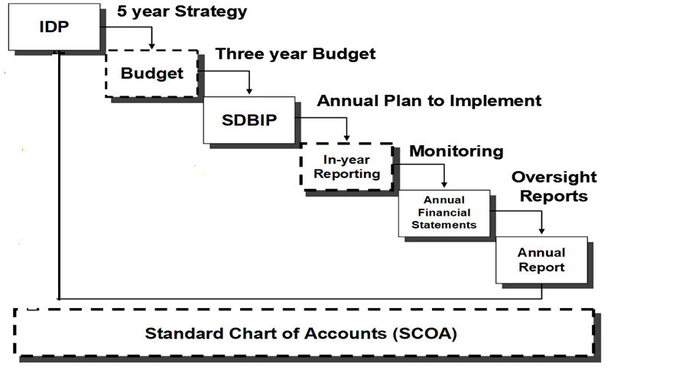
MFMA reporting - Once Source of Truth
Notes:
At CaseWare we have been supporting local government in South Africa for more than 10 years. We are very excited that National Treasury is now in the process of aligning the data source for the in year reporting to the data source for the annual financial statements. This means that now the oversight role will be easier than ever before and all the financial information should align much more with far less differences between the in year reporting and those figures audited and reported on for the full year. This should hopefully also ensure that in year reporting improves. We also believe that this will bring the budget office and the financial reporting team in municipalities closer than ever before.
Some of the items we pick up that result in the in year and year end figures differing are:
Accruals are not raised each month during the year. These are often raised at year end and distort the quarter 4 and annual results. This should be an item of focus in your municipality. Look at the items raised at year end and determine which of those should be a monthly accrual and build a check list into your month end process.
Depreciation is also often posted once a year or sometimes once a quarter; again this should be part of the monthly process.

Slide 10
Dynamic Management Reporting
Notes:
Section 71 reports contain all the information to run a municipality; however the format may be too detailed or overwhelming for non financial professionals; modern management reporting tools have dynamic visualisation of the information that can present it in a way that is much easier to understand and interact with. At Adapt IT we are working on a management reporting solution for local government that will :
Enable reporting of information in a far more visual way that can be understood by all
Enable monthly forecasting at a functional unit level that can easily be aggregated and consolidated; the easier this process is the more likely you are to have people engage the process and take ownership
Enable information to be distributed far more frequently and timeously; this will enable faster responsiveness on any areas that need attention; all responsible leaders across the business should have access to this information and not have to only refer to the S71 reporting pack.

Slide 11
Dynamic Management Reporting
Notes:
If we look at forecasting on a dynamic management reporting tool:
On the left you will see the information you are familiar with on the S71 report
On the right hand side in yellow you will see the forecast figures. From this screen these can be dynamically updated by the relevant functional manager. This tool will then automatically aggregate it and enable the finance team to produce forecasts far more quickly than ever before.
In our business it took our managers just a few forecasting cycles to become totally familiar with both their numbers, the process and the tools. This significantly increased the ownership they took of their financial information and financial plans. This made them feel far more empowered to deliver the value that they had promised in the budget process to communicate changes that had impacted those plans. We believe similar tools and processes could have far reaching impacts on all spheres of public sector.
When financial information is also readily available to a far wider group of leadership on a more frequent, timeous and ongoing basis you also create an environment where everyone knows everyone is watching. This is where a cultural shift starts to happen and the likelihood for fraud and corruption starts reducing.

Slide 12
Start with culture…..
Notes:
So in closing I would like to leave you with these thoughts:
Financial Professionals are highly regarded in most organisations.
Start small – use every opportunity you have to influence and lead
With your own teams talk about fraud and corruption and our responsibilities as financial teams
Create a culture that questions things that don’t make sense or look right; they probably aren’t
Get to know your business and your partners and through that get them to know their numbers
Make sure you invest in the right tools to make the processes as easy as possible to create time for analysis, review and discussion.
And finally – never underestimate the impact you may have; just take the first step

